Slide 1
Chapter 11 Motion in a Circle

Slide 2
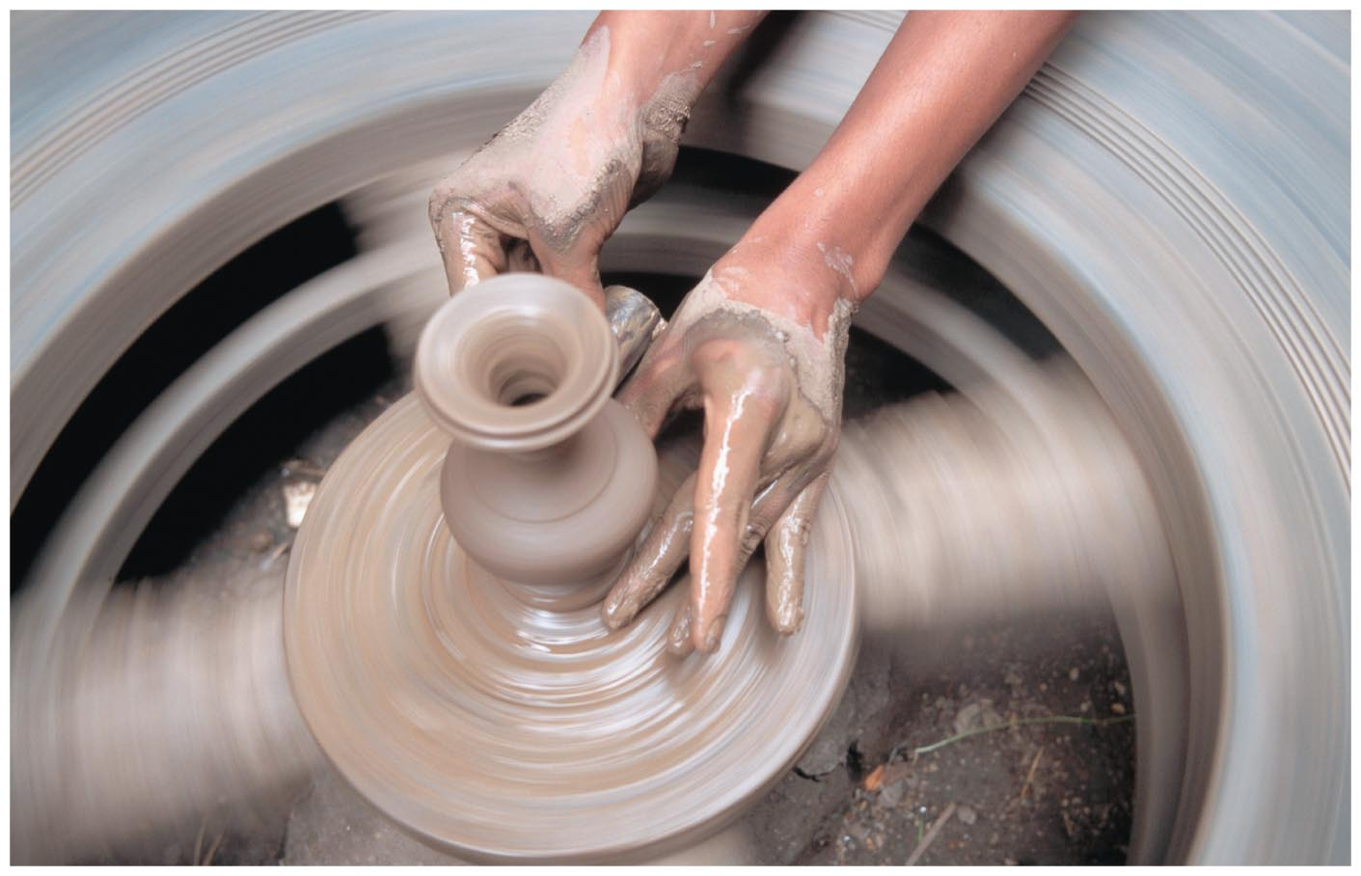
Chapter 11: Motion in a Circle
Chapter Goal: Develop the tools that allow us to understand the kinematics and dynamics of particles and extended objects moving in circular motion centered on an axis of rotation.

Slide 3
Concepts
Chapter 11: Motion in a Circle

Slide 4
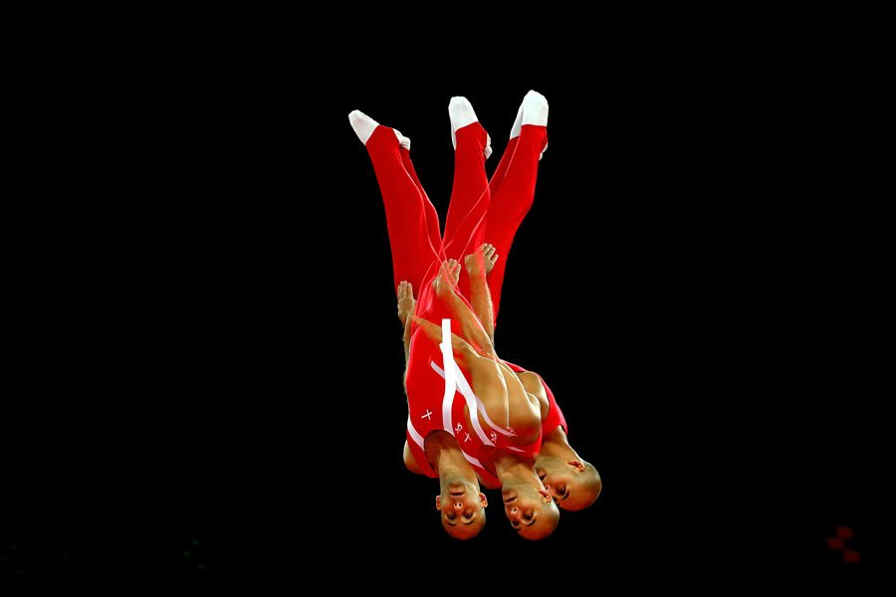
Chapter 11: Motion in a Circle

Slide 5
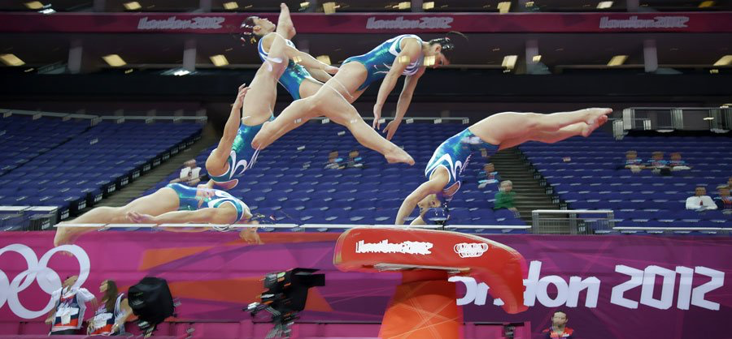
Chapter 11: Motion in a Circle

Slide 6
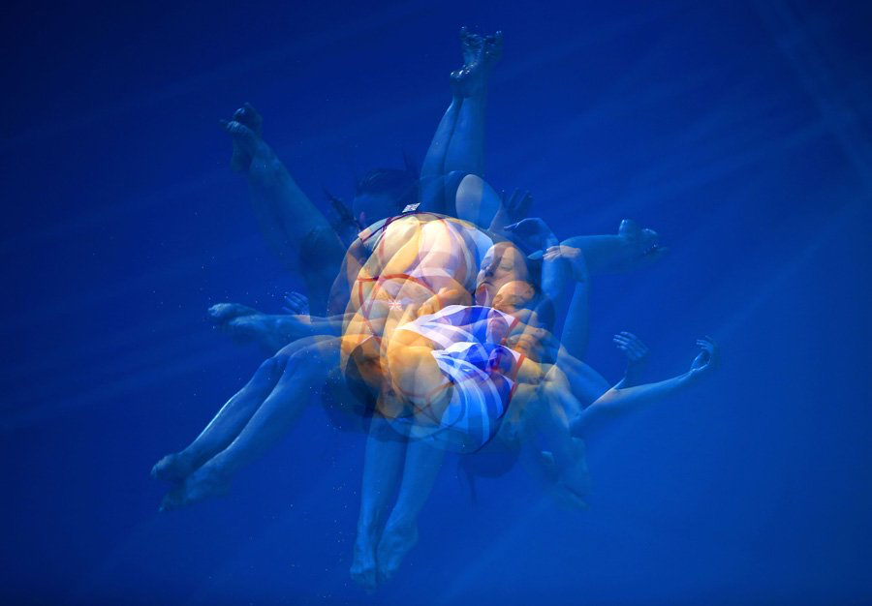
Chapter 11: Motion in a Circle

Slide 7
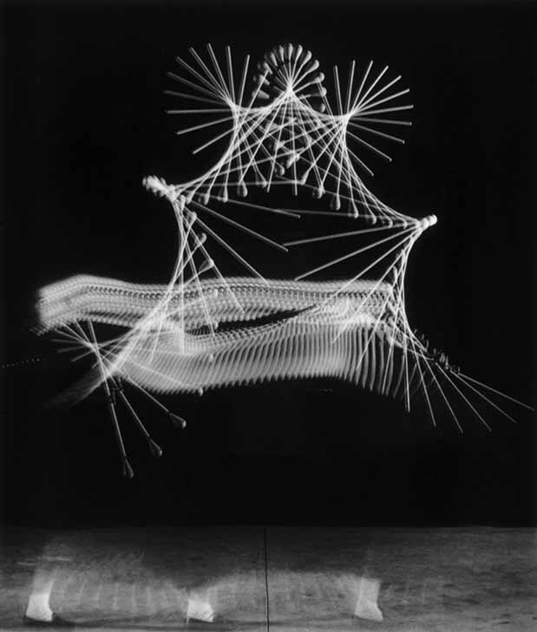
Chapter 11: Motion in a Circle

Slide 8
Chapter 11: Motion in a Circle

Slide 9
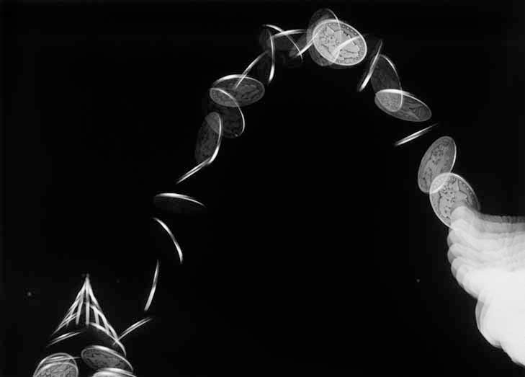
Chapter 11: Motion in a Circle

Slide 10
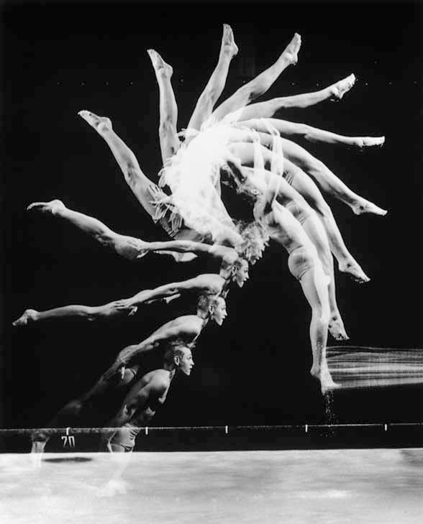
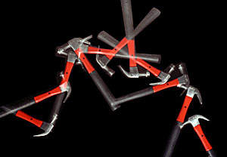
Chapter 11: Motion in a Circle
http://demonstrations.wolfram.com/MotionOfTwoBallsConnectedByARod/
https://www.youtube.com/watch?v=DY3LYQv22qY

Slide 11
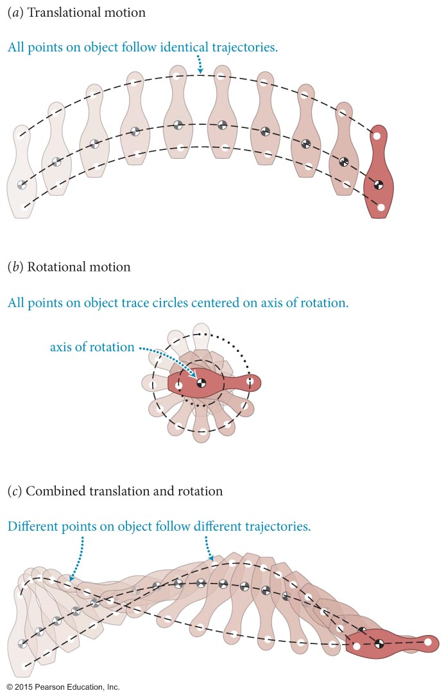
Chapter 11: Motion in a Circle
The motion we have been dealing with so far is called translational motion (figure part a).
In this chapter we will start exploring rotational motion.
In rotational motion (figure parts b and c), the orientation of the object changes, and the particles in the object follow different circular paths centered on the axis of rotation.

Slide 12
Section 11.1: Circular motion at constant speed
The puck revolves around the vertical axis through a circular path.

Slide 13
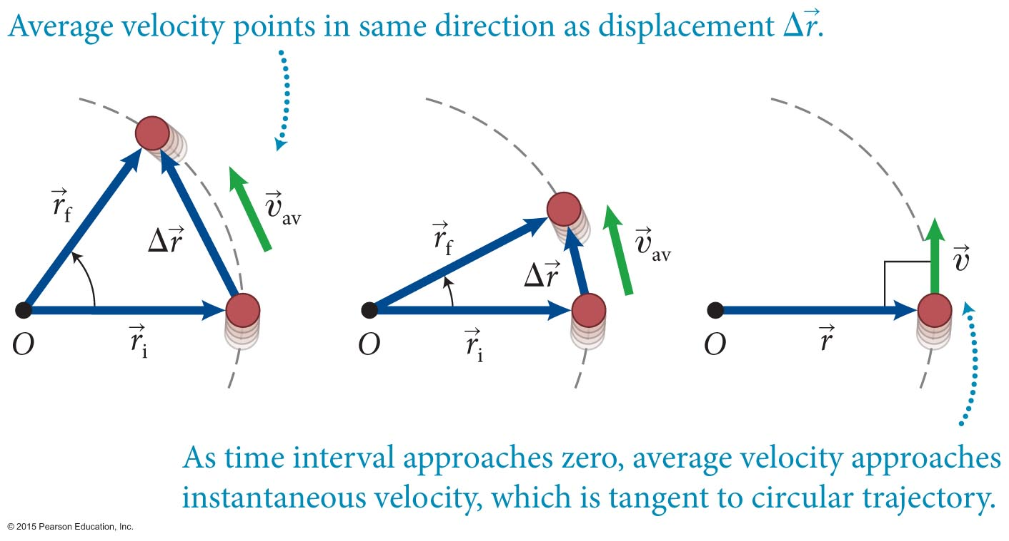
Section 11.1: Circular motion at constant speed
The instantaneous velocity of an object in circular motion is always perpendicular to the object’s position measured from the center of the circular trajectory.
In the first part of this chapter, we study only objects in circular motion at constant speed.

Slide 14
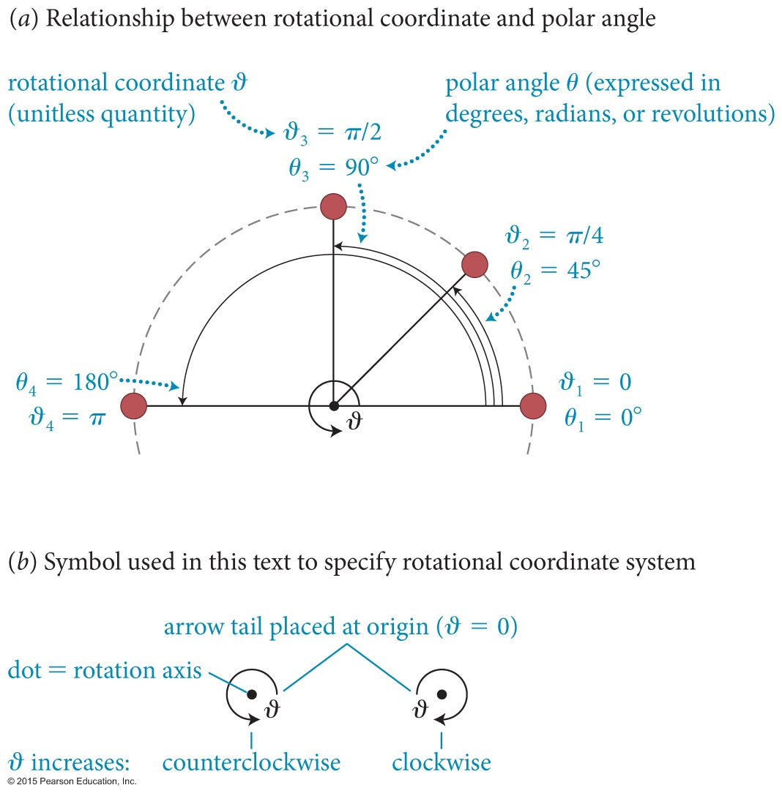
Section 11.1: Circular motion at constant speed
The position of an object in circular motion can be given in polar coordinates (r, θ ).
The magnitude of the position vector of an object in circular motion is the radius.
To specify the direction of motion, we define the object’s rotational coordinate (ϑ ), as illustrated in part a of the figure.
As shown in part b, the direction of increase of ϑ is denoted by a curved arrow around the axis of rotation.

Slide 15
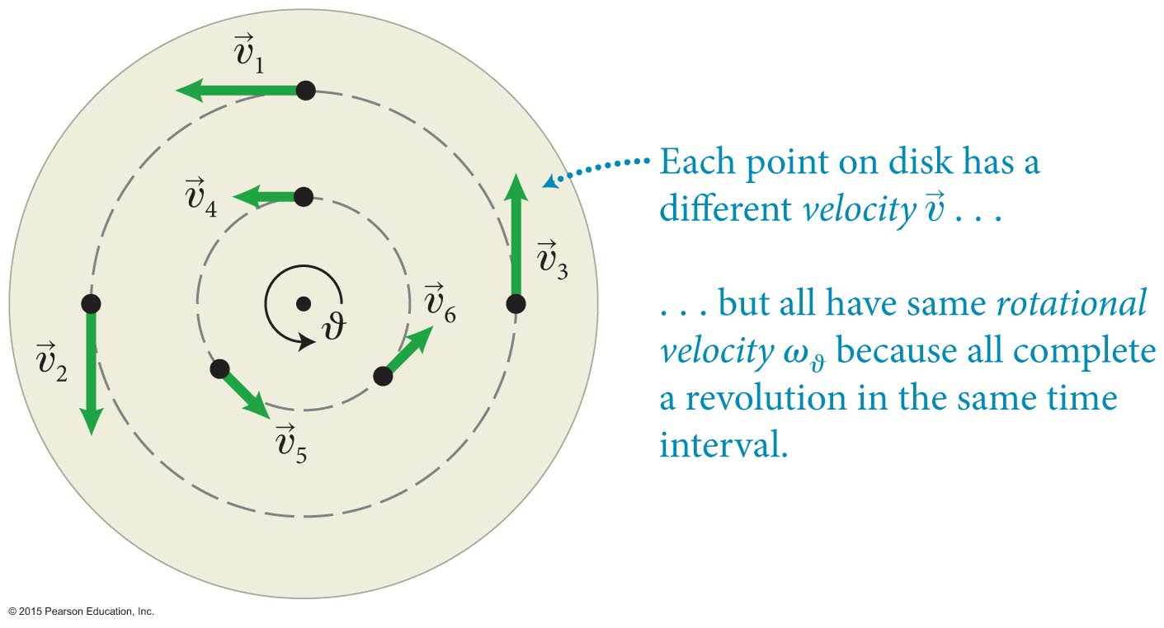
Section 11.1: Circular motion at constant speed
The relationship between an object’s speed and angular velocity is illustrated in the figure below.
All points on the rotating disc will have the same rotational velocity.
However, the speed depends on the radius of the circle: The further the point on the disc from the rotation axis, the larger the speed.

Slide 16
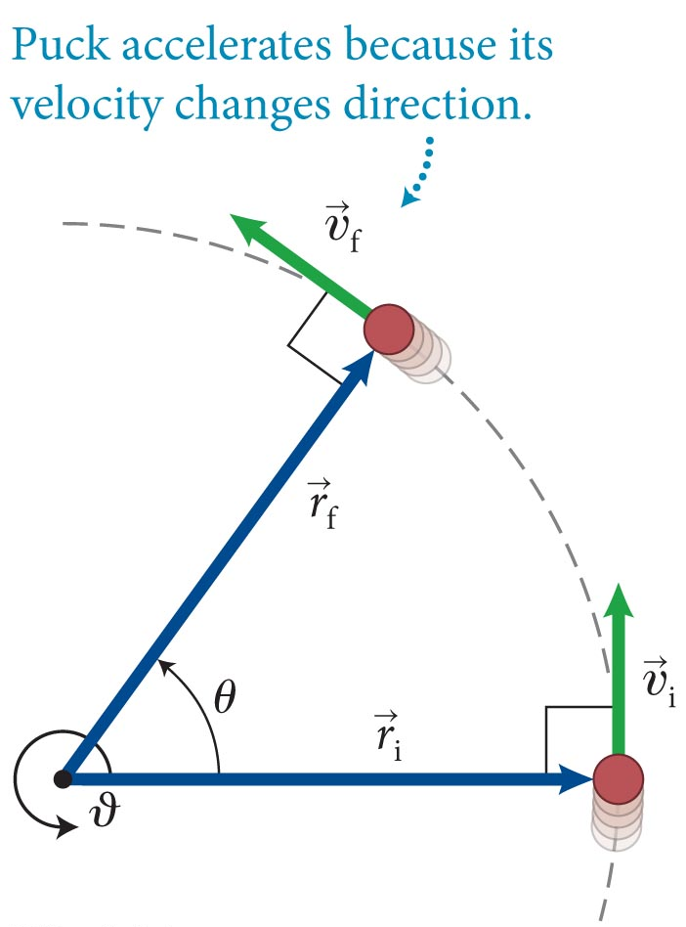
Section 11.1: Circular motion at constant speed
Even though the initial and final speeds of the object in circular motion are the same, the object undergoes a change in velocity
The object is accelerating, even if the speed is constant.
points toward the center of the circle.

Slide 17
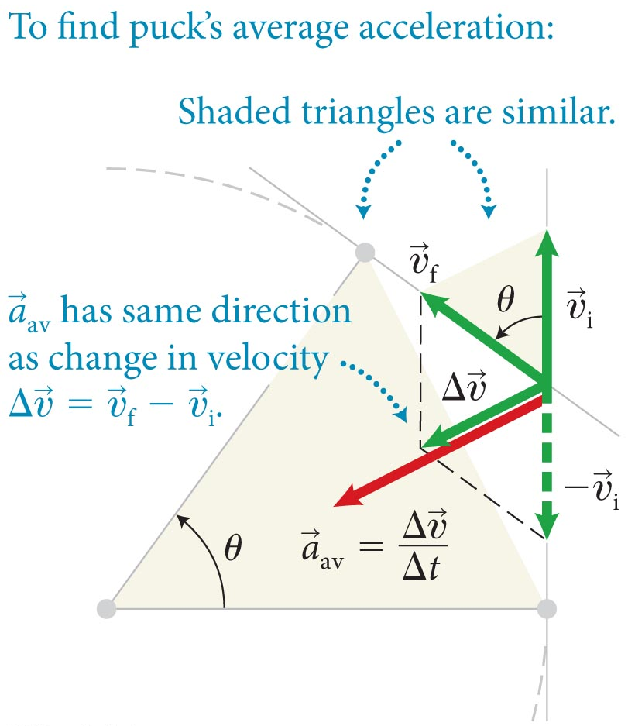
Section 11.1: Circular motion at constant speed
This means the average accelerating also points toward the center.
An object executing circular motion at constant speed has an acceleration of constant magnitude that is directed toward the center of its circular path.
This acceleration is called the centripetal acceleration.

Slide 18
Section 11.2: Forces and circular motion
The centripetal acceleration of an object in circular motion at constant speed points toward the center of the circle. Then from Newton’s second law:
An object that executes circular motion at constant speed is subject to a force (or vector sum of forces) of constant magnitude directed toward the center of the circular trajectory.

Slide 19
Section 11.2: Forces and circular motion
Suppose you round a curve in a car as shown below. The car exerts a force on you that points toward the center.
However, you feel as if you are being pushed outward. Why?
This feeling of being pushed outward rises only from the noninertial nature of the car’s reference frame.
Avoid analyzing forces from a rotating frame of reference because such a frame is accelerating and therefore noninertial.

Slide 20
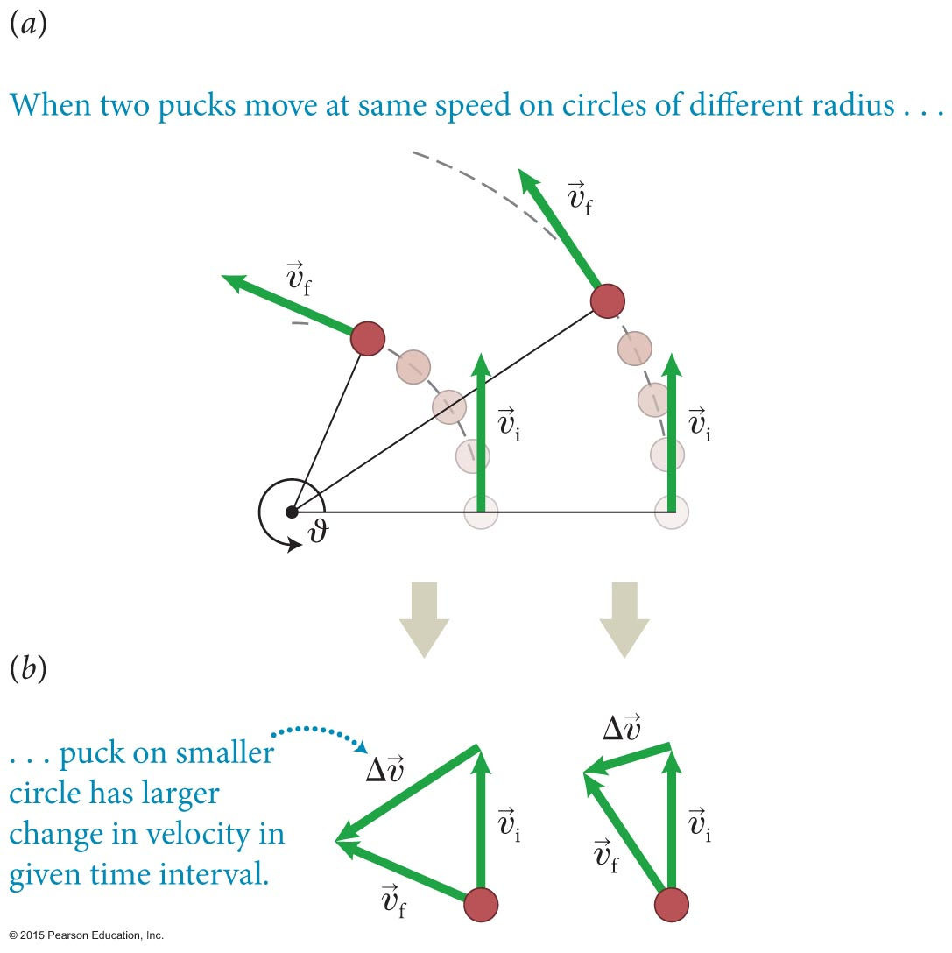
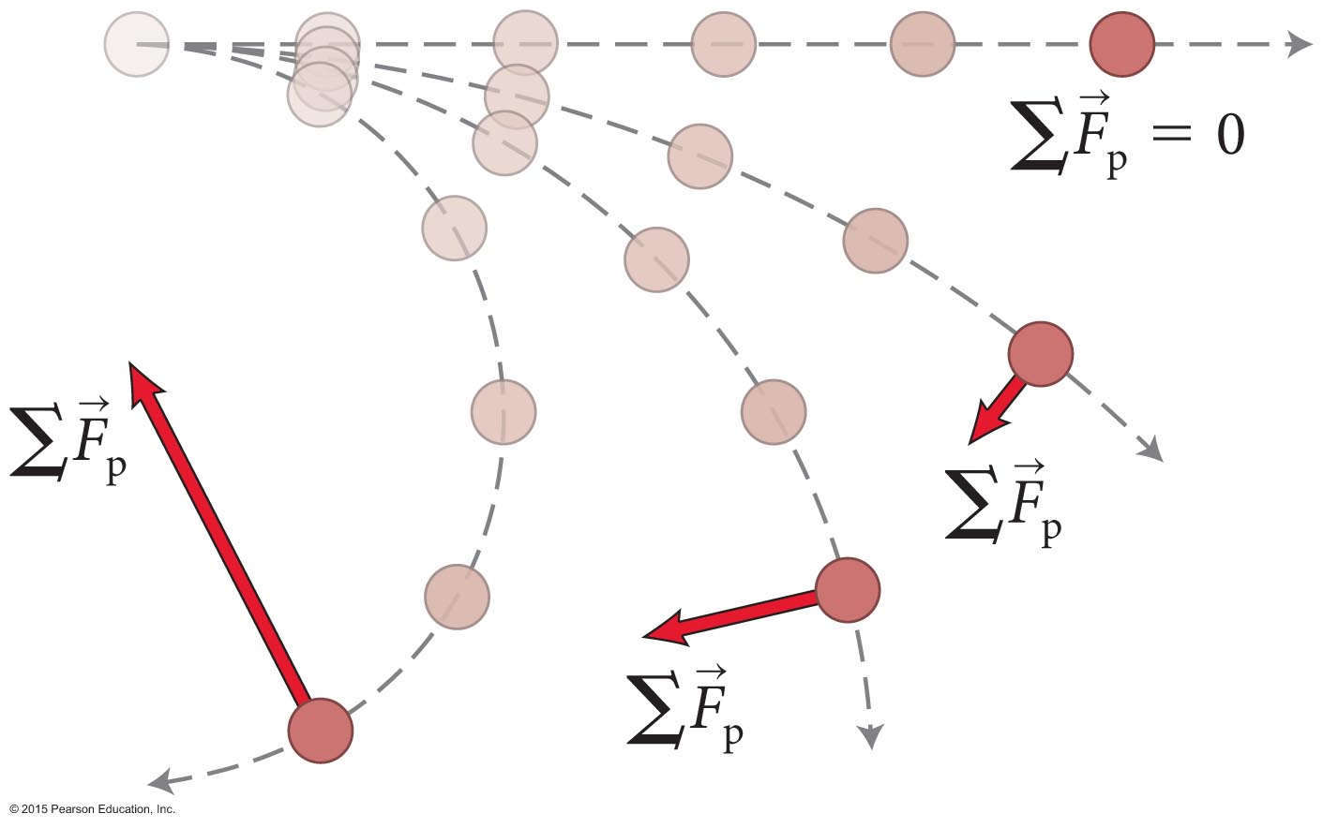
Section 11.2: Forces and circular motion
To see how the inward force depends on radius, look at the two figures below.
We can conclude that
The inward force required to make an object move in a circular motion increases with increasing speed and decreases with increasing radius.

Slide 21
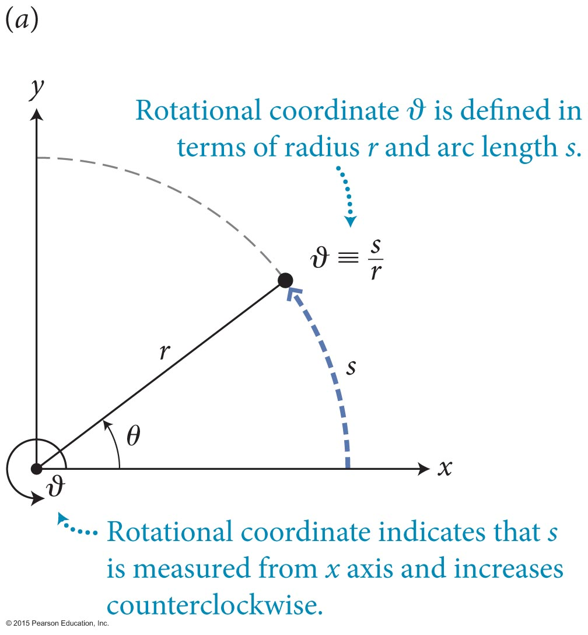
Section 11.4: Motion in a Circle
The rotational coordinate (ϑ) is defined as
The sign and magnitude of s (and ϑ) depend on the choice of rotational coordinate system.
ϑ is unitless. In contrast, the polar angle θ can be expressed in radians, degrees, or revolutions, where
2π rad = 360° = 1 rev
Given θ we can obtain ϑ from: ϑ = θ/(1 rad).
The change in the rotational coordinate Δϑ is given by

Slide 22
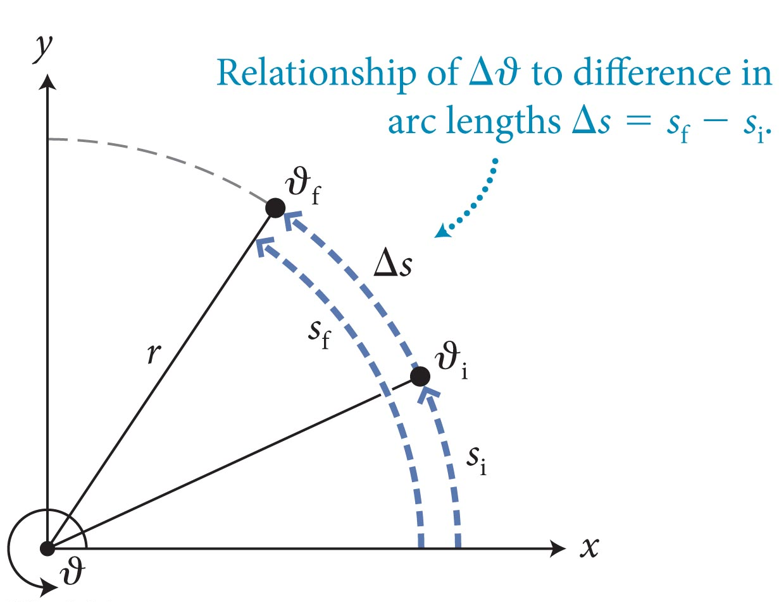
Section 11.4: Motion in a Circle
The rotational velocity is defined as:
The rotational Speed is ω = |ω_{ϑ}|.
The tangential component of velocity (υ_{t}) and ω_{ϑ} are signed quantities that are positive in the direction of increasing ϑ.
In terms of speed:
υ = rω
or υ_{t} = rω_{ϑ}

Slide 23
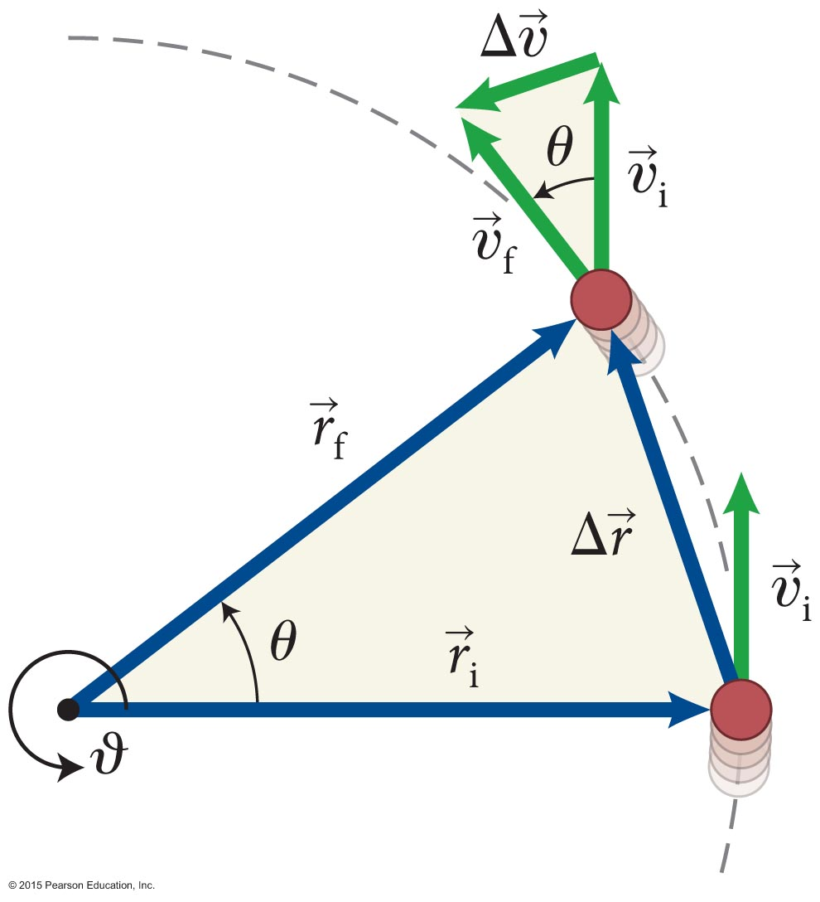
Section 11.4: Motion in a Circle
The rotational acceleration is defined as
Two similar triangles
Small angle:
centripetal acceleration

Slide 24
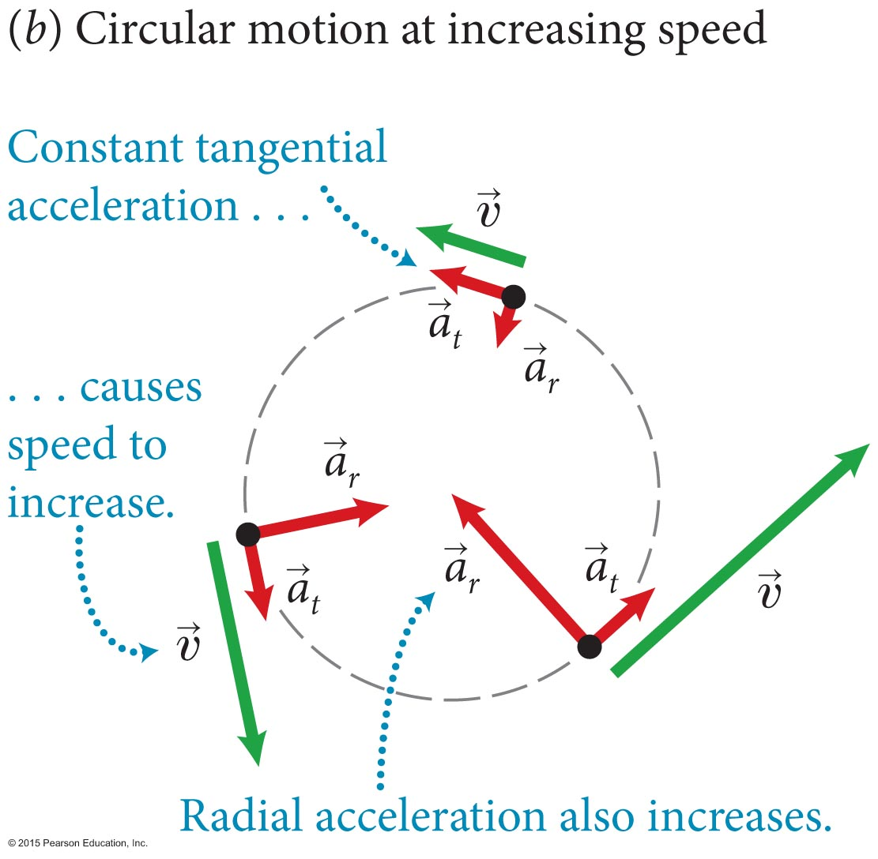
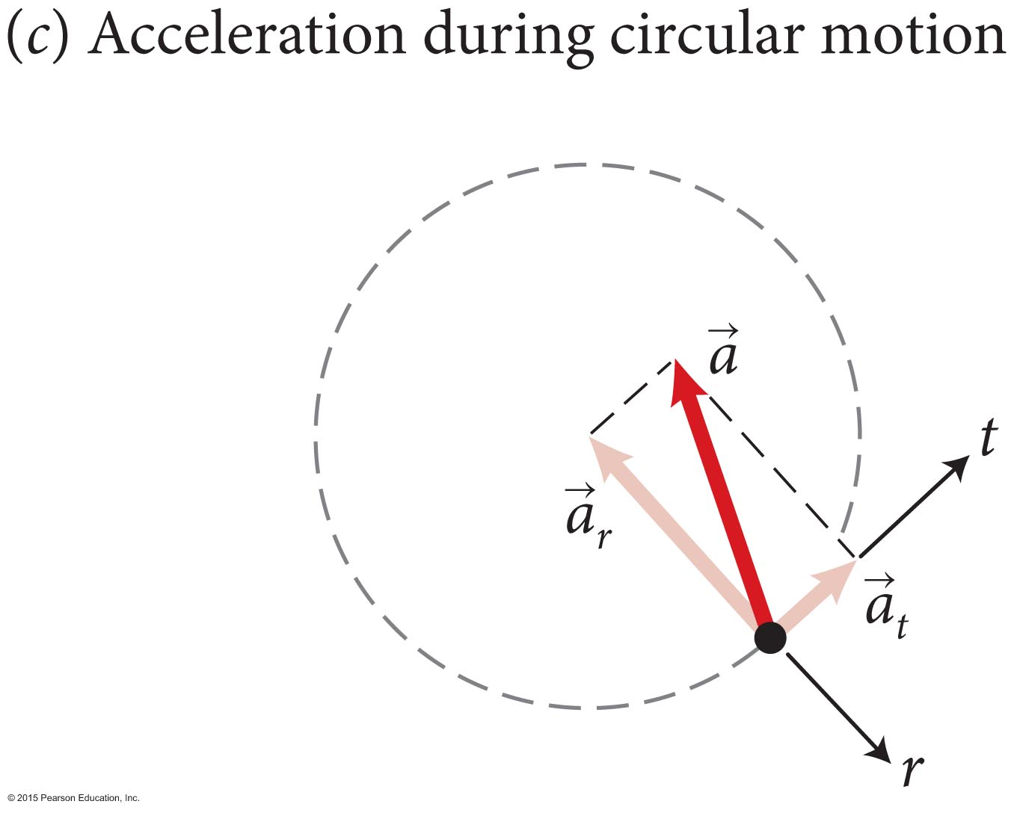
Section 11.4: Motion in a Circle
For any type of circular motion: υ_{r} = 0 and a_{r} = –υ²/r.
When the object’s speed is not constant, there is a tangential acceleration component given by
Or, using α_{ϑ} = dω_{ϑ} /dt
a_{t} = rα_{ϑ}
If the object in circular motion speeds up or slows down, the magnitude of acceleration is

Slide 25
Section 11.4: Motion in a Circle
The relationship between rotational and translational motion translational motion quantity = r × rotational motion quantity
Using the kinematic equations developed in Chapter 3, we can obtain the equivalent kinematic equations for rotational motion with constant rotational acceleration (α_{t}):

Slide 26
Section 11.4: Motion in a Circle
The correspondence between translational and rotational quantities and equations.

Slide 27
Chapter 11 Motion in a Circle

Slide 28
Example 11.4 Leaning into a curve
Section 11.4: Rotational kinematics
A women is rollerblading to work and, running late, rounds a corner at full speed, sharply leaning into the curve. If, during the turn, she goes along the arc of a circle of radius 4.5 m at a constant speed of 5.0 m/s, what angle θ must her body make with the vertical in order to round the curve without falling?

Slide 29
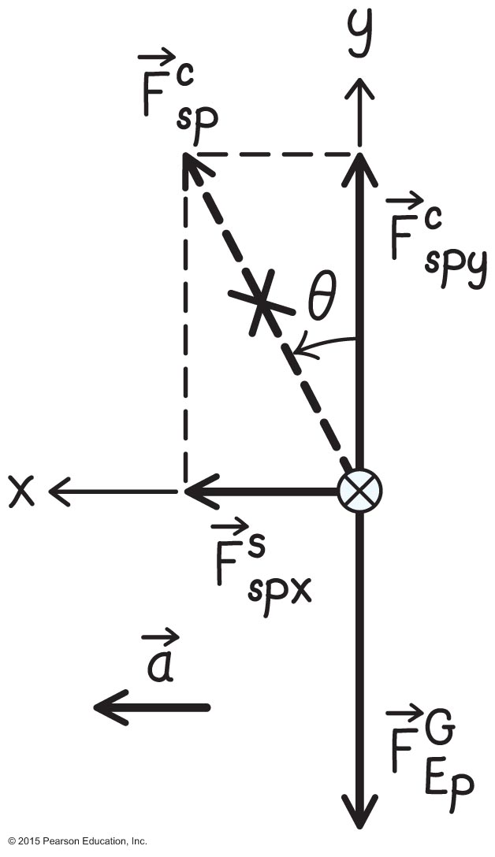
Example 11.4 Leaning into a curve (cont.)
Section 11.4: Rotational kinematics
❶ GETTING STARTED The woman executes circular motion at constant speed. She must therefore undergo a centripetal acceleration as a result of the forces exerted on her.

Slide 30
Example 11.4 Leaning into a curve (cont.)
Section 11.4: Rotational kinematics
❶ GETTING STARTED The forces exerted on the rollerblader are the gravitational force and a contact force exerted by the surface of the road.

Slide 31
Example 11.4 Leaning into a curve (cont.)
Section 11.4: Rotational kinematics
❷ DEVISE PLAN First, the forces in the y direction must add to zero: Second, the x component of the contact force provides the centripetal acceleration . This gives two equations from which I should be able to determine θ.

Slide 32
Example 11.4 Leaning into a curve (cont.)
Section 11.4: Rotational kinematics
❸ EXECUTE PLAN Substituting the centripetal acceleration into the equation of motion in the x direction
where m is the inertia of the rollerblader. (The rollerblader’s inertia is not given, but I hope it will drop out and I won’t need it.)

Slide 33
Example 11.4 Leaning into a curve (cont.)
Section 11.4: Rotational kinematics
❸ EXECUTE PLAN
In the x direction
In the y direction
The equation of motion in the y direction then yields

Slide 34
Example 11.4 Leaning into a curve (cont.)
Section 11.4: Rotational kinematics
Solving this equation for
This gives an angle θ = tan^{–1}(0.57) = 0.52 rad, or about 30°.

Slide 35
Checkpoint 11.6
Estimate the maximum speed with which you could take the curve in Example 11.4. [Hint: What is the maximum coefficient of static friction?]
11.6

Slide 36
Section Goals
Section 11.5: Angular momentum
You will learn to
Generalize the concepts of momentum, inertia, and kinetic energy to rotational cases.
Relate the equations for translational momentum and kinetic energy to rotational situations.
Apply the law of the conservation of angular momentum.

Slide 37
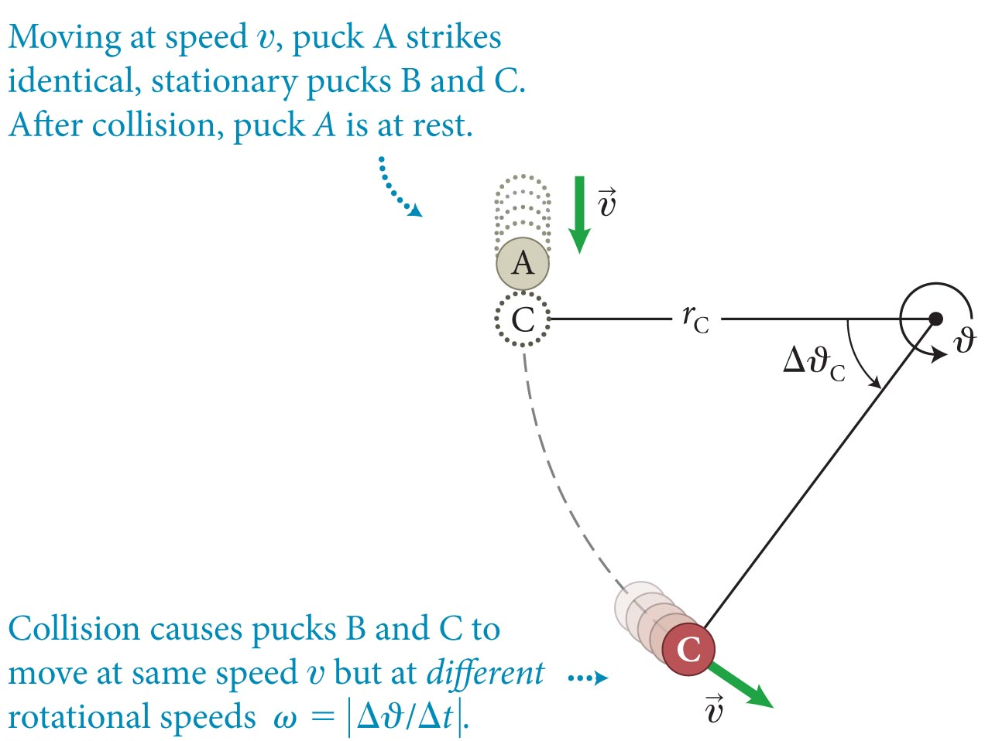
Section 11.5: Angular momentum
A stationary puck C fastened to a string of length r is struck by an identical puck moving at speed υ. Treating the puck C as a particle,
its kinetic energy can be written as
Defining the term in the parenthesis as the rotational inertia I of the particle about the axis of rotation, I ≡ mr², we get
where K_{rot} is the rotational kinetic energy.
The SI units of I are kg ⋅ m².

Slide 38
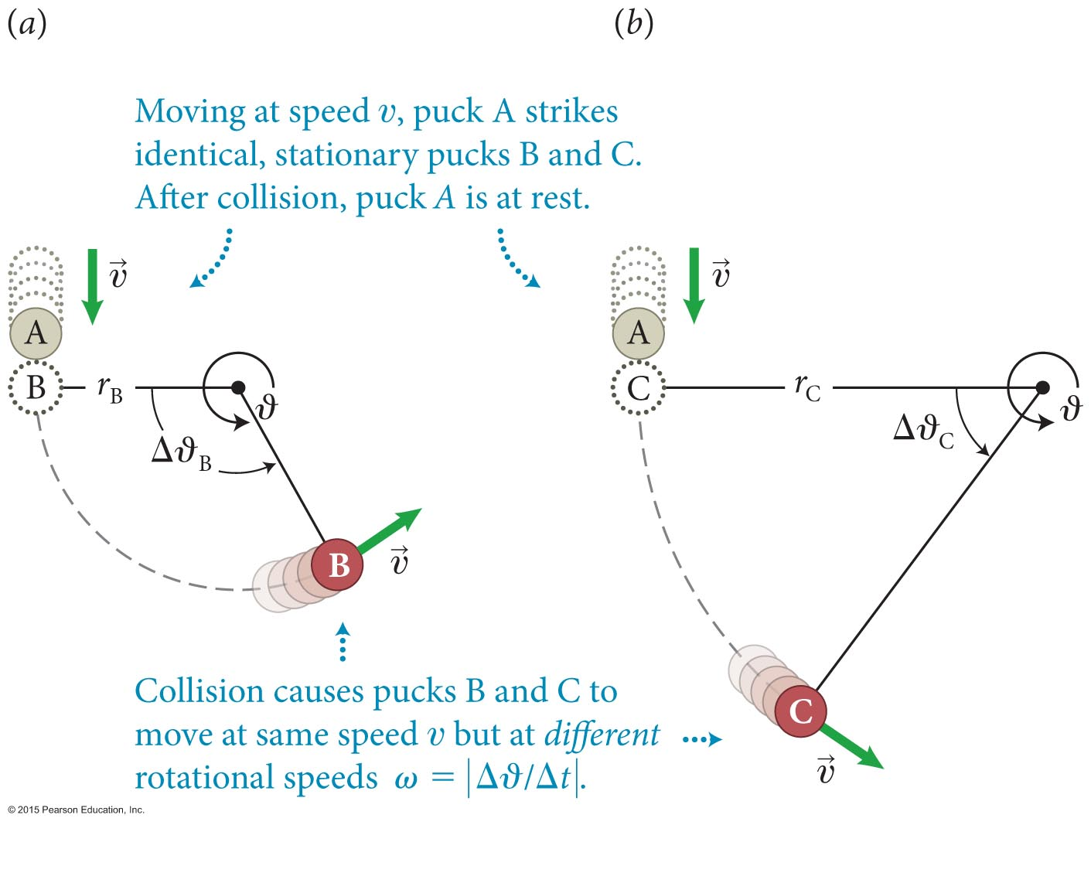
Checkpoint 11.7
Given r_{C} = 2r_{B}. (a) What is the ratio of the rotational velocity of B to that of C? (b) What is the ratio of the rotational inertia of B to that of C?
I = mr²
B is easier to rotate.
Less rotational inertial.

Slide 39
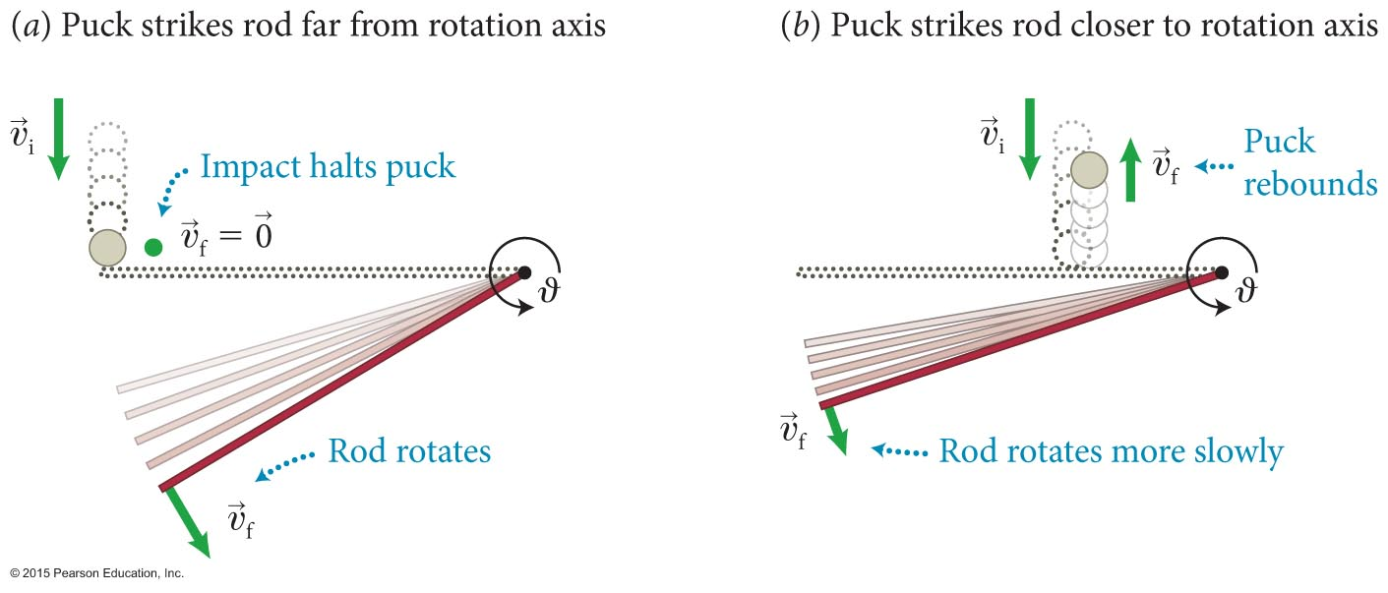
Section 11.5: Angular momentum
Consider the two collisions shown in the figure: In both cases the rods and pucks are identical and the puck has the same initial velocity.
For the puck, using I = mr² and ω = υ/r, we get Iω = rmυ.
The larger the value of Iω (as in case a), the more easily the object can set another object in rotation.

Slide 40
Section 11.5: Angular momentum
The quantity L_{ϑ} ≡ Iω_{ϑ} is called the angular momentum,
The SI units of L are: kg ⋅ m²/s.

Slide 41
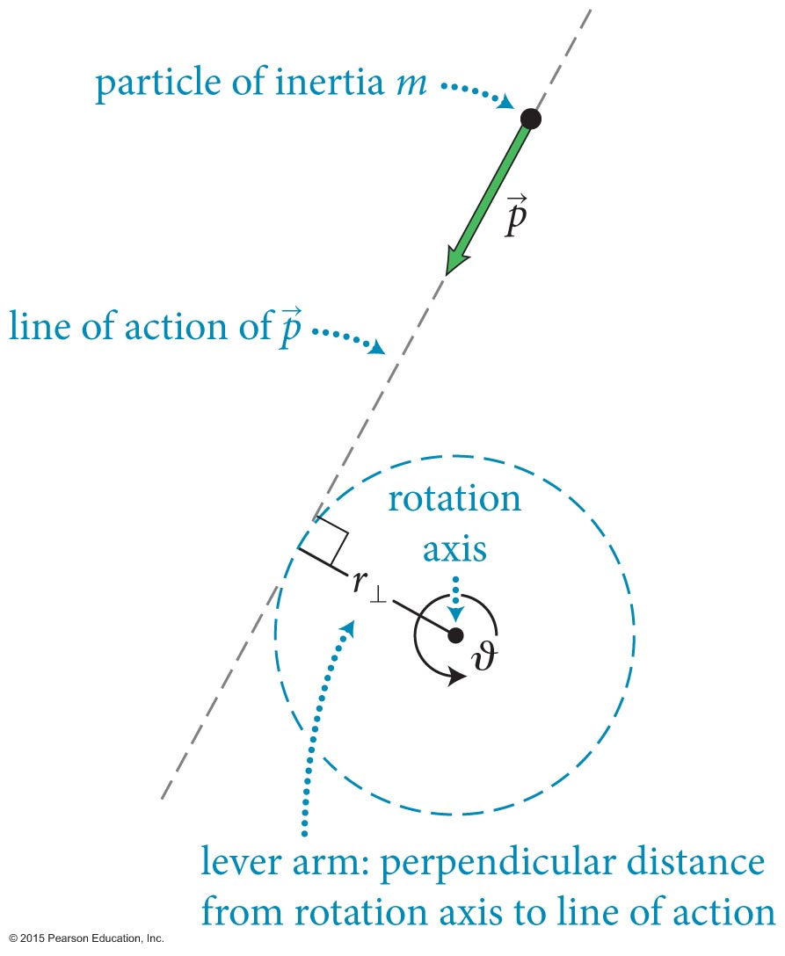
Section 11.5: Angular momentum
As illustrated in the figure, the object does not have to rotate or revolve to have a nonzero L.
r⊥ is called the lever arm.
Then, the angular momentum of a particle that moves in a straight line is
L = r⊥ mυ (particle)

Slide 42
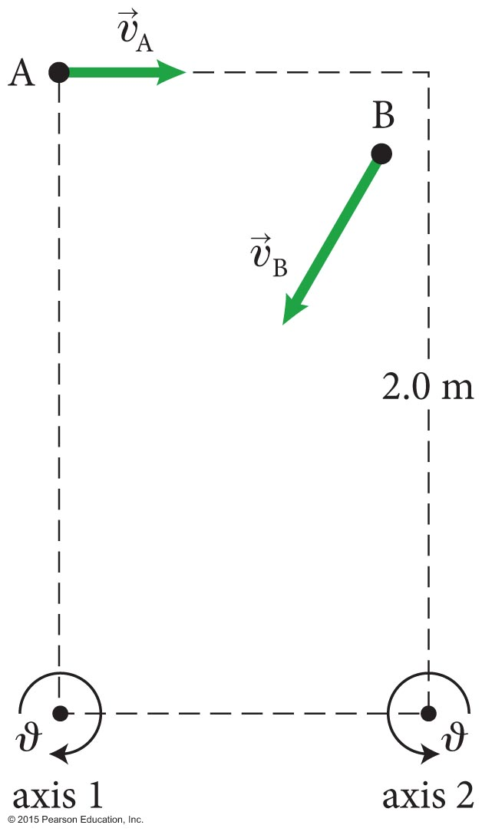
Exercise 11.5 Angular momenta
Section 11.5: Angular momentum
Determine the angular momenta of objects A and B in Figure 11.29 relative to (a) axis 1 and (b) axis 2. The inertia of the objects are m_{A} = 2.0 kg and m_{B} =0.50 kg, and their speeds are υ_{A} = 0.60 m/s and υ_{B} = 1.0 m/s. The tall side of the rectangle is 2.0 m long and object B travels along the diagonal, which makes an angle of 30° with the long side of the rectangle.

Slide 43
Exercise 11.5 Angular momenta (cont.)
Section 11.5: Angular momentum
SOLUTION (a) Object A: The lever arm distance relative to axis 1 is the long side of the rectangle: r⊥ = 2.0 m. The angular momentum is therefore
L_{Aϑ} = +(2.0 m)(2.0 kg)(0.60 m/s) = +2.4 kg ⋅ m²/s.
The plus sign indicates that the rotational coordinate of A relative to axis 1 increases.✔
Object B: B’s line of motion is the diagonal of the rectangle and so goes through axis 1. Therefore r⊥ = 0 and thus L_{Bϑ} = 0.✔

Slide 44
Exercise 11.5 Angular momenta (cont.)
Section 11.5: Angular momentum
SOLUTION (b) Object A: The lever arm distance relative to axis 2 is the long side of the rectangle: r⊥= 2.0 m. The angular momentum is therefore L_{Aϑ} = –(2.0 m)(2.0 kg)(0.60 m/s) =
–2.4 kg ⋅ m²/s. The minus sign indicates that the rotational coordinate of A relative to axis 2 decreases.✔

Slide 45
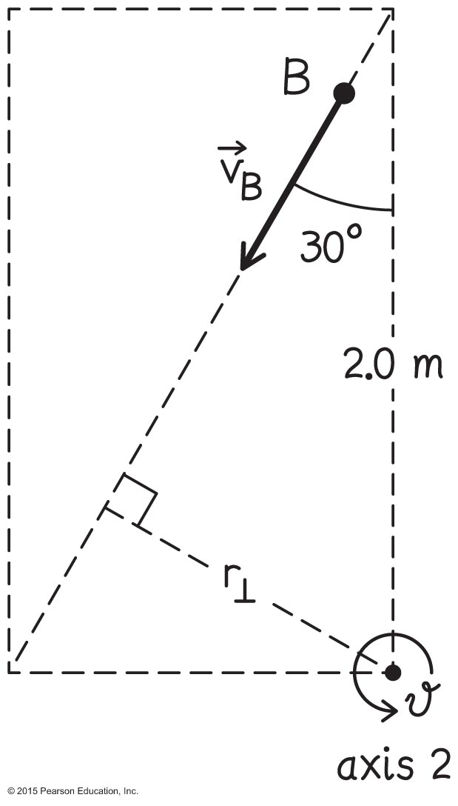
Exercise 11.5 Angular momenta (cont.)
Section 11.5: Angular momentum
SOLUTION Object B: To determine r⊥ relative to axis 2, draw a straight line perpendicular to B’s line of motion (Figure 11.30). Using trigonometry,
sin 30° = r⊥/(2.0 m), or
r⊥= (0.5)(2.0 m) = 1.0 m,
and so
L_{Bϑ} = +(1.0 m)(0.50 kg)(1.0 m/s)
= +0.50 kg ⋅ m²/s.
The plus sign indicates that the rotational coordinate of B relative to axis 2 increases.✔

Slide 46
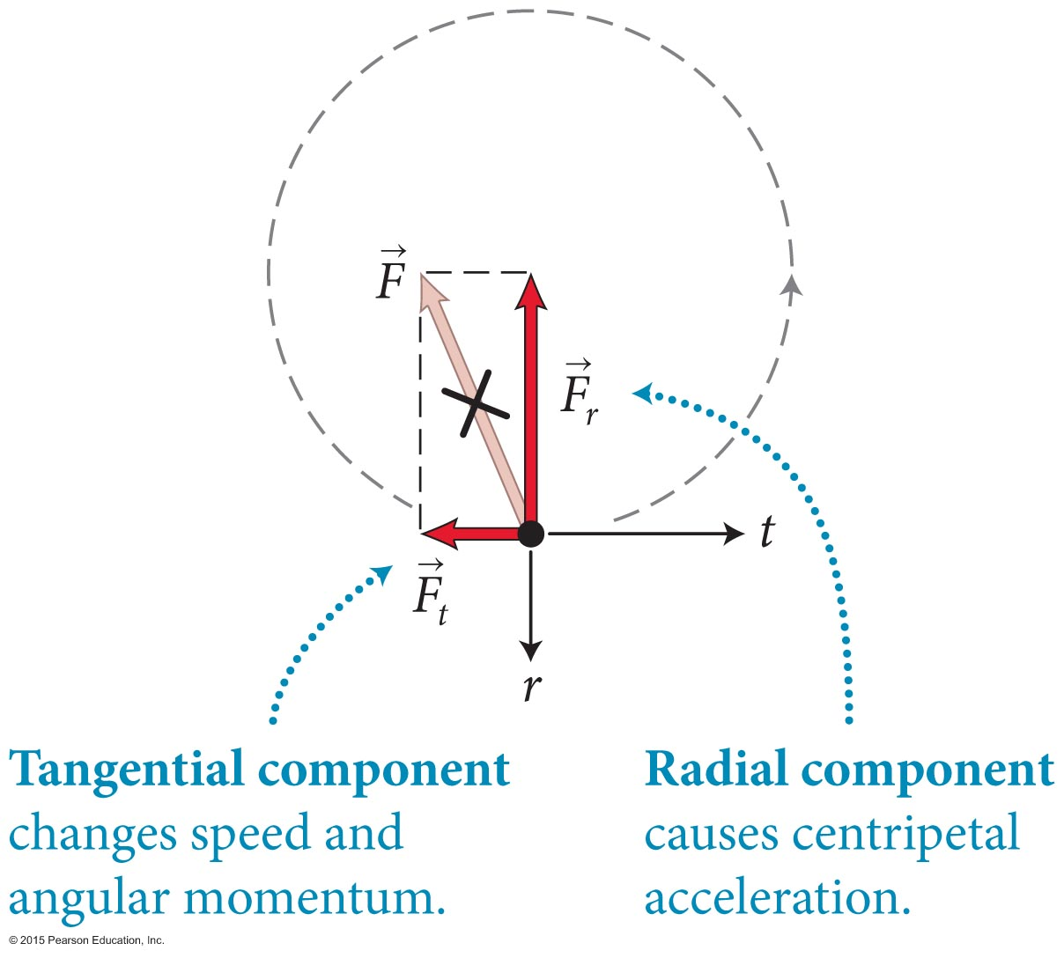
Section 11.5: Angular momentum
Consider the particle in circular motion shown in the figure:
The radial component of the force keeps the particle moving in a circle.
The tangential component causes the particle’s angular momentum to change.
In the absence of the tangential component, the angular momentum remains constant.

Slide 47
Chapter 11 Motion in a Circle

Slide 48
Section 11.5: Angular momentum
Conservation of angular momentum:
Angular momentum can be transferred from one object to another, but it cannot be created or destroyed.
In the absence of tangential forces
ΔL_{ϑ} = 0
and angular momentum is constant

Slide 49
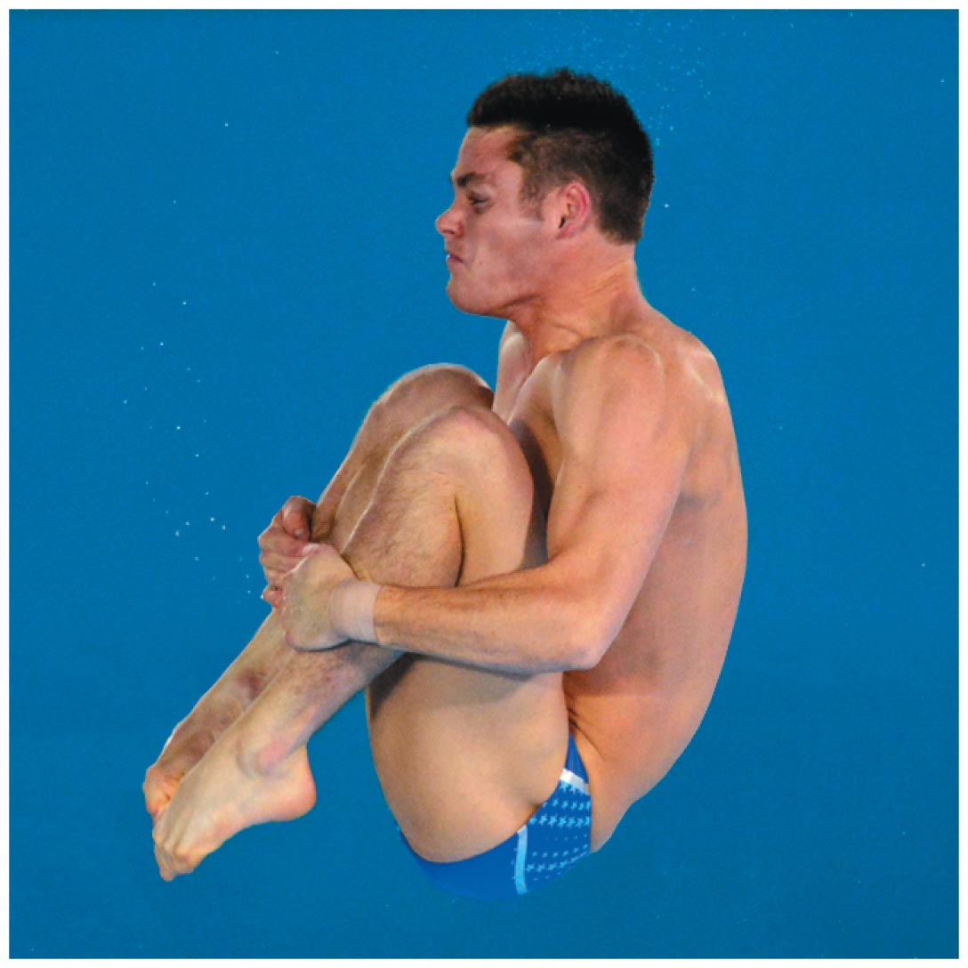
Exercise 11.6 Spinning faster
Section 11.5: Angular momentum
https://www.youtube.com/watch?v=AQLtcEAG9v0
http://www.nsf.gov/news/special_reports/olympics/figureskating.jsp
2:20 – 4:20
Divers increase their spin by tucking in their arms and legs. Suppose the outstretched body of a diver rotates at 1.2 revolutions per second before he pulls his arms and knees into his chest, reducing his rotational inertia from 9.4 kg ∙ m² to 3.1 kg ∙ m². What is his rotational velocity after he tucks in his arms and legs?

Slide 50
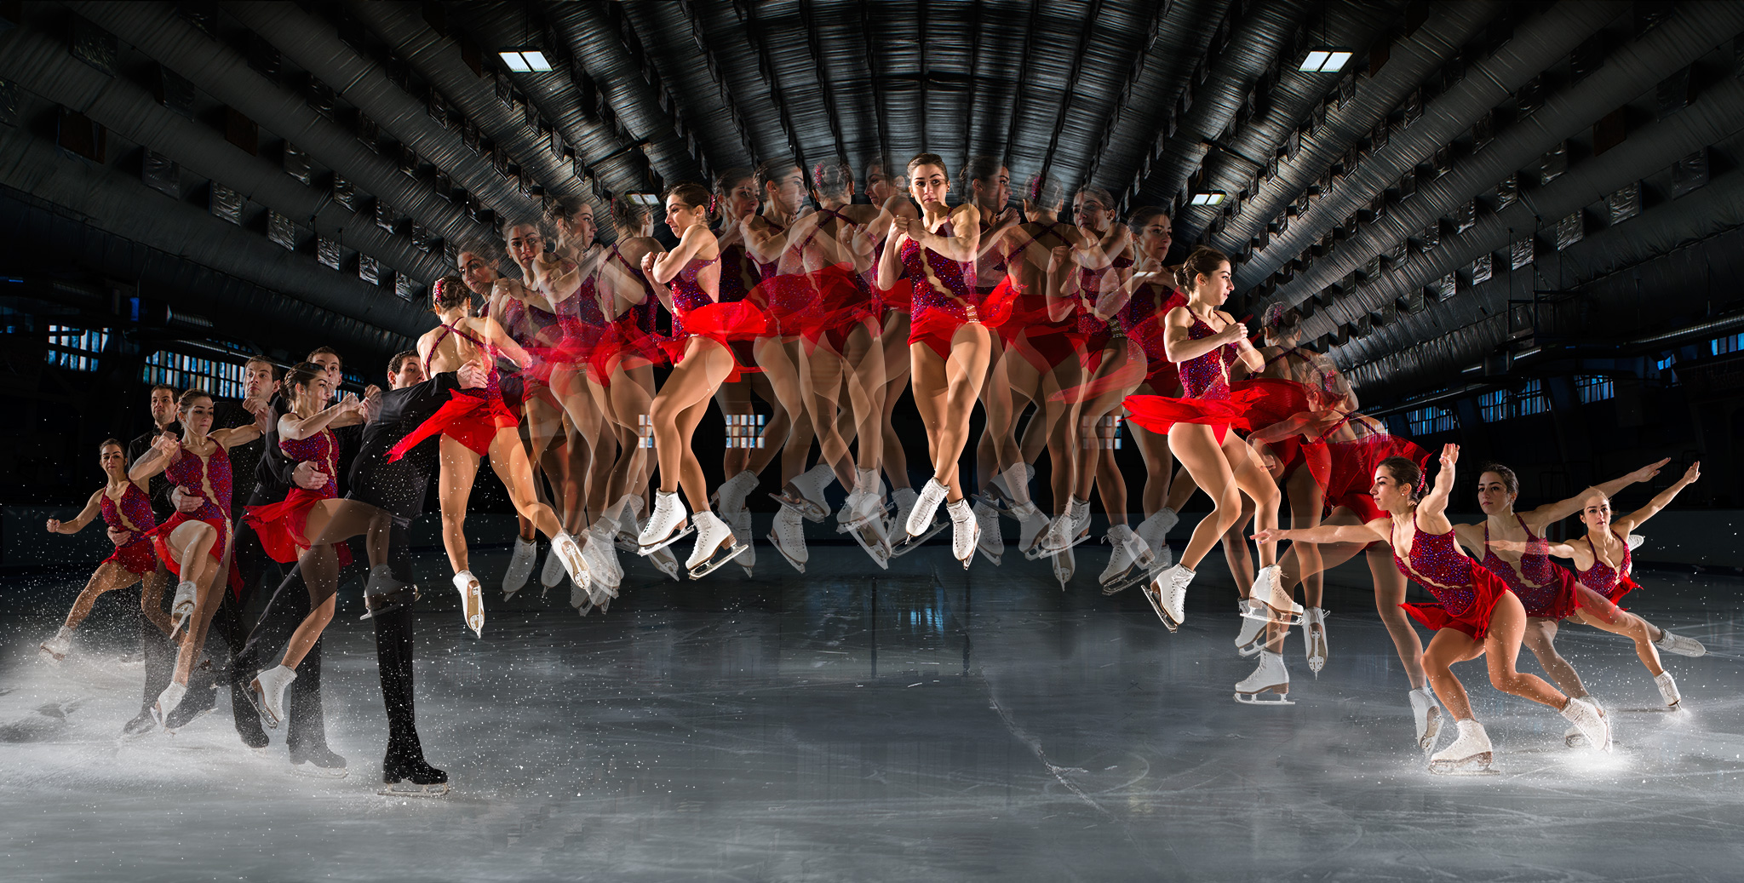
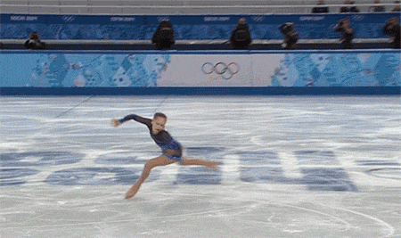
Checkpoint 11.8
Does the rotational kinetic energy of the skater change as she pulls her limbs in?
11.8
Force inward on “hands” needed to provide circular motion.
Force outward on “arms” by Third Law.
Therefore to pull arms inwards, work has to be done by arms of skater. Muscle energy is converted to kinetic energy.
F_{ah} = -F_{ha}
_{inward outward}
hand
arm

Slide 51
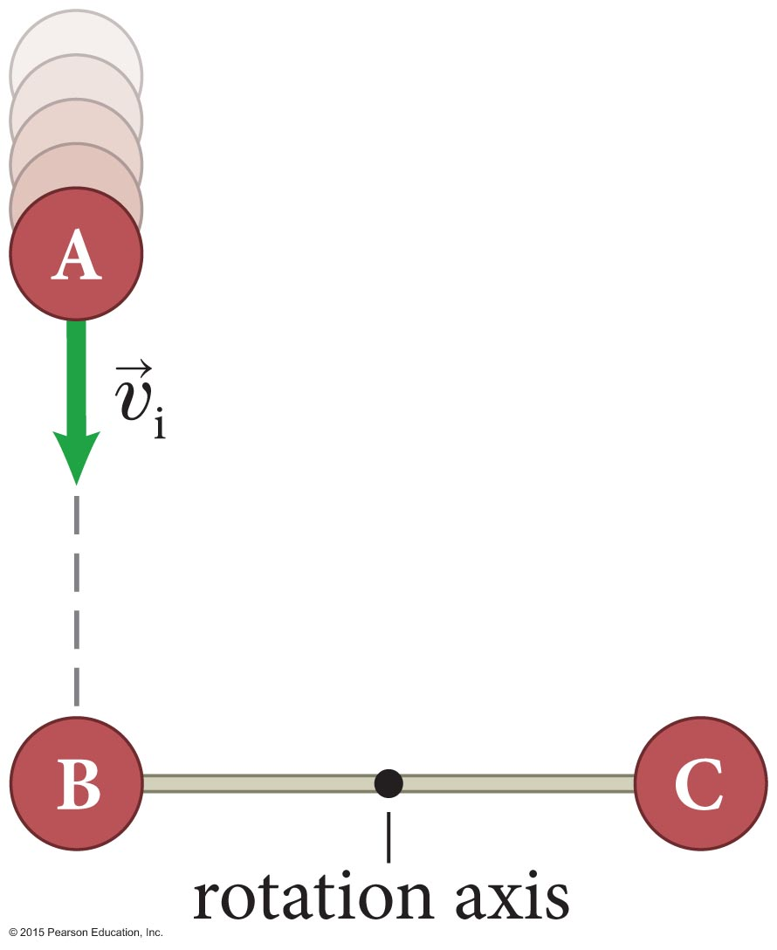
Example 11.7 Dumbbell collision
Section 11.5: Angular momentum
Two identical pucks B and C, each of inertia m, are connected by a rod of negligible inertia and length ℓ that is free to rotate about a fixed axis through its center. A third identical puck A, initially moving at speed υ_{i}, strikes the combination as shown. After the elastic collision, what are the rotational velocity of the dumbbell and the velocity of puck A?

Slide 52
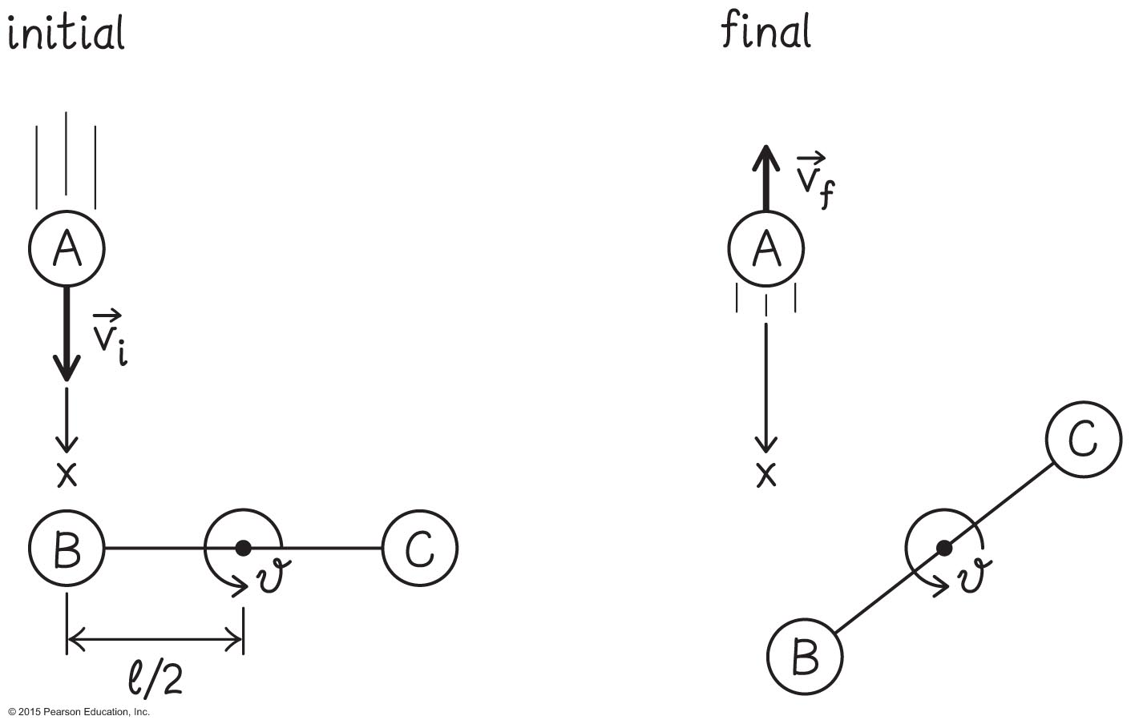
Example 11.7 Dumbbell collision (cont.)
Section 11.5: Angular momentum
❶ GETTING STARTED Begin with a two-part sketch (Figure 11.34), choosing an x axis in the direction of A’s initial motion and choosing counterclockwise as the positive direction of rotation (this is the direction in which I expect the dumbbell to rotate after the collision, but it doesn’t matter which direction you chose).

Slide 53
Example 11.7 Dumbbell collision (cont.)
Section 11.5: Angular momentum
❶ GETTING STARTED Because A hits B head-on and because the inertia of the dumbbell is twice that of A, I expect A to bounce back and move in the negative x direction after the collision, as my after-collision sketch shows.

Slide 54
Example 11.7 Dumbbell collision (cont.)
Section 11.5: Angular momentum
❷ DEVISE PLAN In elastic collisions the kinetic energy of the system remains constant (see Section 5.5). In this collision I need to consider the kinetic energy of puck A and the rotational kinetic energy of the dumbbell. Because there are two unknowns—A’s final velocity and the dumbbell’s final rotational velocity—I need an additional law to determine both. To this end I apply conservation of angular momentum (Eq. 11.38) to the system comprising puck A and the dumbbell.

Slide 55
Example 11.7 Dumbbell collision (cont.)
Section 11.5: Angular momentum
❸ EXECUTE PLAN The initial kinetic energy of the system is that of puck A, . The final kinetic energy is the sum of the (translational) final kinetic energy of A and the rotational kinetic energy of the dumbbell, , where I is the rotational inertia of the dumbbell.

Slide 56
Example 11.7 Dumbbell collision (cont.)
Section 11.5: Angular momentum
❸ EXECUTE PLAN Ignoring the negligible inertia of the rod, I can say that each puck in the dumbbell contributes a rotational inertia m(ℓ/2)² given by Eq. 11.30, so that the rotational inertia of the dumbbell is I = 2 m(ℓ/2)².
(1)

Slide 57
Example 11.7 Dumbbell collision (cont.)
Section 11.5: Angular momentum
❸ EXECUTE PLAN Because the collision is elastic, the final kinetic energy must equal the initial kinetic energy, and so
Dividing both sides by gives

Slide 58
Example 11.7 Dumbbell collision (cont.)
Section 11.5: Angular momentum
❸ EXECUTE PLAN Conservation of angular momentum. The change in A’s angular momentum is, from Eq. 11.36,

Slide 59
Example 11.7 Dumbbell collision (cont.)
Section 11.5: Angular momentum
❸ EXECUTE PLAN The initial angular momentum of the dumbbell about the rotation axis is zero. L_{dϑ,i} = 0; its final angular momentum about this axis is, from Eq. 11.34,
L_{dϑ,f} = Iω_{ϑ,f}. The change in the dumbbell’s angular momentum is thus

Slide 60
Example 11.7 Dumbbell collision (cont.)
Section 11.5: Angular momentum
❸ EXECUTE PLAN Because the system is isolated, its angular momentum doesn’t change (Eq. 11.38), and so
ΔL_{ϑ} = ΔL_{Aϑ} + ΔL_{dϑ}
or υ_{i} = υ_{f} + ℓω_{f} (3)

Slide 61
Example 11.7 Dumbbell collision (cont.)
Section 11.5: Angular momentum
❸ EXECUTE PLAN
υ_{i} = υ_{f} + ℓω_{f} angular momentum
kinetic energy
Solve for υ_{f}
Use quadratic formula

Slide 62
Section Goal
Section 11.6: Rotational inertia of extended objects
Compute the rotational inertia for collections of particles and extended objects.

Slide 63
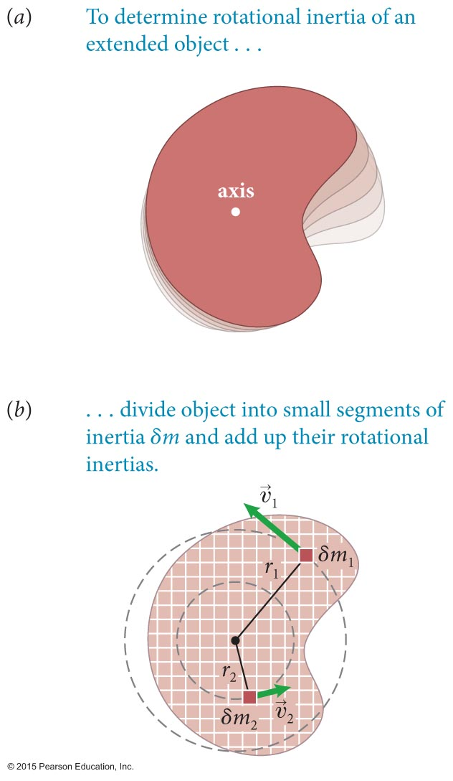
Section 11.6: Rotational Inertia of extended objects
To apply the concepts of rotational inertia to extended objects as seen in the figure (part a), imagine breaking down the object to small segments (part b).
The rotational kinetic energy of the object is the sum of the kinetic energies of these small elements:
Using υ = rω, we get

Slide 64
Section 11.6: Rotational Inertia of extended objects
Using the definition of rotational inertia,
The rotational inertia of the extended object is given by
In the limit δm_{n} → 0, the sum becomes

Slide 65
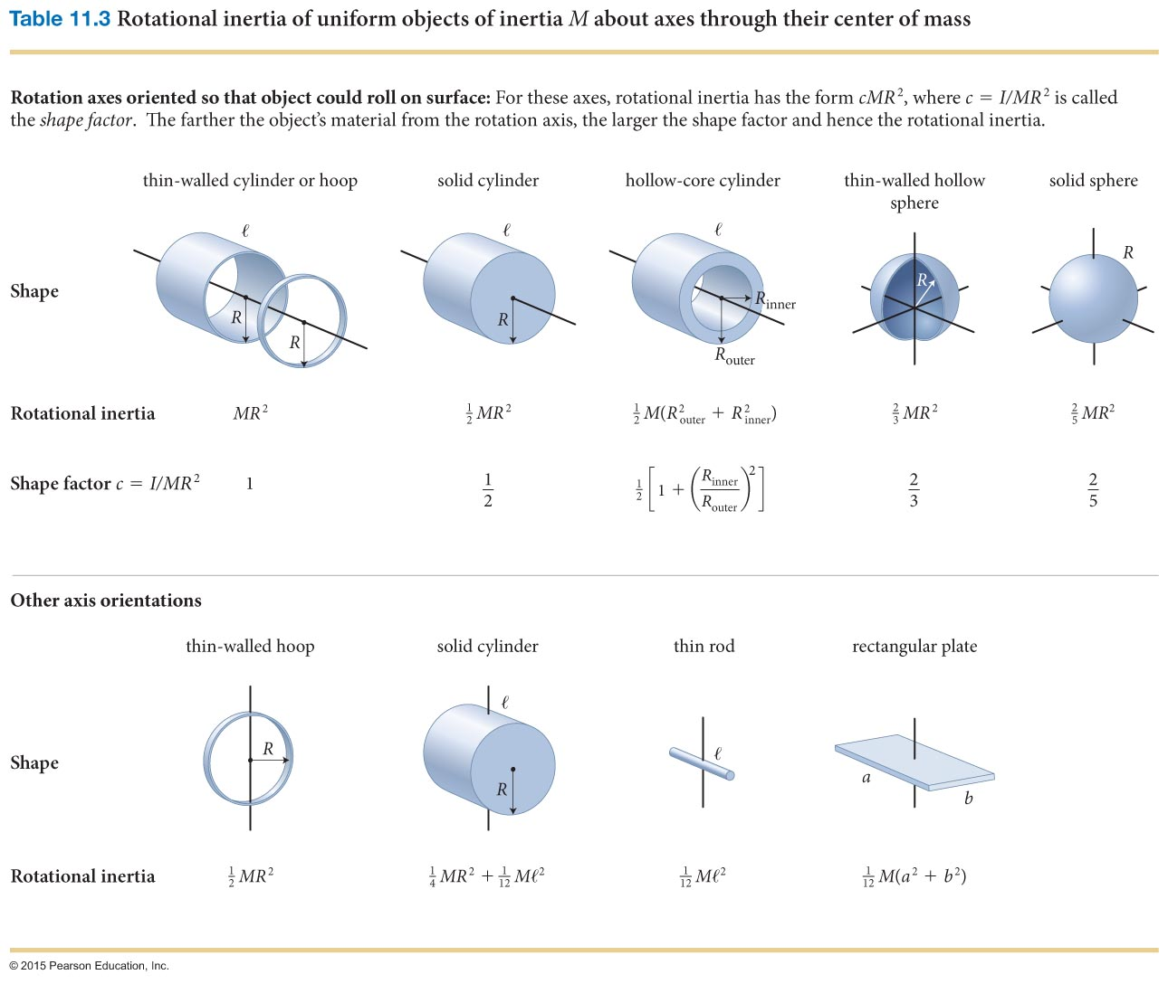
https://www.youtube.com/watch?v=7PRZ5IIT5Tg
Section 11.6: Rotational Inertia of extended objects
https://www.youtube.com/watch?v=l-FUTMzsKUQ
https://www.youtube.com/watch?v=8psVQHHUEcI sphere (c = 0.4), disk (c = 0.5), ring (c = 1)

Slide 66
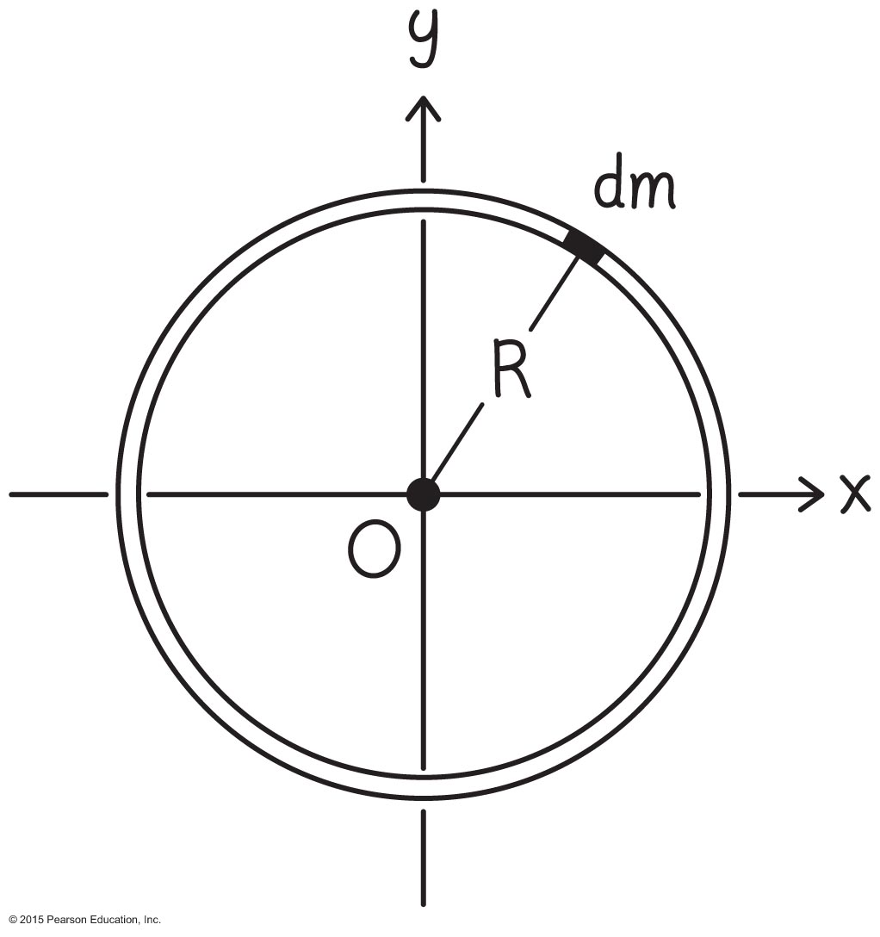
Example 11.8 Rotational inertia of a hoop about an axis through its center
Section 11.6: Rotational inertia of extended objects
Calculate the rotational inertia of a hoop of inertia m and radius R about an axis perpendicular to the plane of the hoop and passing through its center.

Slide 67
Example 11.8 Rotational inertia of a hoop about an axis through its center (cont.)
Section 11.6: Rotational inertia of extended objects
❷ DEVISE PLAN Equation 11.43 gives the rotational inertia of an object as the sum of the contributions from many small segments. Divide the hoop into infinitesimally small segments each of inertia dm. Each segment lies the same distance r = R from the rotation axis (one such segment is shown in Figure 11.36). This means I can pull the constant r² = R² out of the integral in Eq. 11.43, making it easy to calculate.

Slide 68
Section 11.6: Rotational inertia of extended objects
❹ EVALUATE RESULT This result makes sense because all the material contained in the hoop lies at the same distance R from the rotation axis. Therefore the rotational inertia of the hoop is the same as that of a particle of inertia m located a distance R from the rotation axis, which I know from Eq. 11.30: I = mR².
m, R

Slide 69
Example 11.9 Rotational inertia of a rod about an axis through its center
Section 11.6: Rotational inertia of extended objects
Calculate the rotational inertia of a uniform solid rod of inertia m and length ℓ about an axis perpendicular to the long axis of the rod and passing through its center.

Slide 70
Section 11.6: Rotational inertia of extended objects
❸ EXECUTE PLAN The inertia per unit length is λ = m/ℓ.

Slide 71
Section 11.6: Rotational inertia of extended objects
❹ EVALUATE RESULT If I approximate each half of the rod as a particle located a distance ℓ/4 from the origin I chose in Figure 11.37, the rotational inertia of the rod would be, from Eq. 11.30, This is not too far from the value I obtained, so my answer appears to be reasonable.

Slide 72
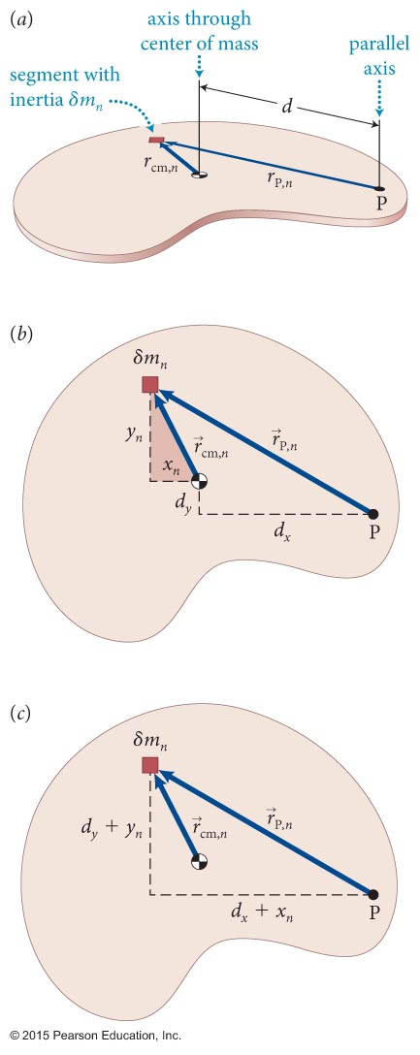
Section 11.6: Rotational Inertia of extended objects
Sometimes you need to know the moment of inertia about an axis through an unusual position (for an example, position P on the object shown in the figure).
You can find it if you know the rotational inertia about a parallel axis through the center of mass:
I = I_{cm} + md ²
This relationship is called the parallel-axis theorem.

Slide 73
Example 11.11 Rotational inertia of a rod about an axis through one end
Section 11.6: Rotational inertia of extended objects
Use the parallel-axis theorem to calculate the rotational inertia of a uniform solid rod of inertia m and length ℓ about an axis perpendicular to the length of the rod and passing through one end.
I = I_{cm} + md ²

Slide 74
Example 11.11 Rotational inertia of a rod about an axis through one end (cont.)
Section 11.6: Rotational inertia of extended objects
❷ DEVISE PLAN In Example 11.9, I determined that the rotational inertia about an axis through the rod’s center is For a uniform rod, the center of mass coincides with the geometric center, so I can use the parallel axis theorem to determine the rotational inertia about a parallel axis through one end.
I = I_{cm} + md ²

Slide 75
Example 11.11 Rotational inertia of a rod about an axis through one end (cont.)
Section 11.6: Rotational inertia of extended objects
❸ EXECUTE PLAN The distance between the rotation axis and the center of mass is and so, with from Example 11.9, Eq. 11.53 yields
✔

Slide 76
Checkpoint 11.12
About what axis is the rotational inertia of an extended object smallest?
11.12
Axis for which the maximum distance from axis is smallest

Slide 77
Section 11.6
Clicker Question 7
Your physics book can be rotated around three mutually perpendicular axes passing symmetrically through its center. About which axis is the rotational inertia smallest? About which axis is it largest?

Slide 78
Section 11.6
Clicker Question 7
Your physics book can be rotated around three mutually perpendicular axes passing symmetrically through its center. About which axis is the rotational inertia smallest? About which axis is it largest?
Parallel to the longest dimension, parallel to the width of the book
Parallel to the longest dimension, perpendicular to the covers of the book
Parallel to the width of the book, parallel to the longest dimension
Parallel to the width of the book, perpendicular to the covers of the book
Perpendicular to the covers of the book, parallel to the longest dimension
Perpendicular to the covers of the book, parallel to the width of the book

Slide 79
Section 11.6
Clicker Question 7
Your physics book can be rotated around three mutually perpendicular axes passing symmetrically through its center. About which axis is the rotational inertia smallest? About which axis is it largest?
Parallel to the longest dimension, parallel to the width of the book
Parallel to the longest dimension, perpendicular to the covers of the book
Parallel to the width of the book, parallel to the longest dimension
Parallel to the width of the book, perpendicular to the covers of the book
Perpendicular to the covers of the book, parallel to the longest dimension
Perpendicular to the covers of the book, parallel to the width of the book

Slide 80
Concepts: Rotational kinematics
Chapter 11: Summary
During rotational motion, all the particles in an object follow circular paths around the axis of rotation.
The rotational velocity ω_{ϑ} of an object is the rate at which the object’s rotational coordinate q changes.
The rotational acceleration α_{ϑ} is the rate at which an object’s rotational velocity changes.

Slide 81
Quantitative Tools: Rotational kinematics
Chapter 11: Summary
When an object travels a distance s along the circumference of a circle of radius r, the object’s rotational coordinate ϑ is a unitless quantity defined as s divided by the circle’s radius:
The arc distance s is measured from the positive x axis. To measure ϑ we need to choose a direction of increasing ϑ and a zero, just as we need to specify a direction of increasing x and an origin to measure position along an axis.

Slide 82
Quantitative Tools: Rotational kinematics
Chapter 11: Summary
For any rotating object, the rotational velocity and rotational acceleration are

Slide 83
Concepts: Translational variables for rotating objects
Chapter 11: Summary
The velocity of an object moving along a circle is always perpendicular to the object’s position vector measured from the axis of rotation.
The tangential component υ_{t} of the velocity is tangent to the circle. The radial component υ_{r} of the velocity is zero.
An object moving in a circle has a nonzero acceleration (even if its speed is constant) because the direction of the velocity changes.
An inward force is required to make an object move in a circle, even at constant speed.

Slide 84
Quantitative Tools: Translational variables for rotating objects
Chapter 11: Summary
The tangential and radial components of the velocity of an object moving along a circular path are
υ_{t} = rω_{ϑ}
υ_{r} = 0.
The radial component of the acceleration is

Slide 85
Quantitative Tools: Translational variables for rotating objects
Chapter 11: Summary
This radial component is called the centripetal acceleration and is directed toward the center of the circle. It can also be written as
a_{r} = –rω².
The tangential component of the acceleration is
a_{t} = rα_{ϑ}.
The magnitude of the acceleration is

Slide 86
Concepts: Constant rotational acceleration
Chapter 11: Summary
If the tangential acceleration a_{t} of a rotating object is constant, its rotational acceleration a_{ϑ} is also constant.
In only that case, the rotational kinematics relationships for constant rotational acceleration apply.

Slide 87
Quantitative Tools: Constant rotational acceleration
Chapter 11: Summary
If an object with constant rotational acceleration α_{ϑ} initially has a rotational coordinate ϑ_{i} and a rotational velocity ω_{ϑ,i}, then after a time interval Δt its rotational coordinate and rotational velocity are

Slide 88
Concepts: Rotational inertia
Chapter 11: Summary
Rotational inertia is a measure of an object’s tendency to resist any change in its rotational velocity.
The rotational inertia depends on the inertia of the object and on how that inertia is distributed.
The SI units of rotational inertia are kilograms-meters-squared (kg ⋅ m²).

Slide 89
Quantitative Tools: Rotational inertia
Chapter 11: Summary
The rotational inertia I of a rotating particle of inertia m is
I = mr²,
where r is the distance from the particle to the rotation axis. For an extended object, the rotational inertia is
The parallel-axis theorem: If I_{cm} is the rotational inertia of an object of inertia m about an axis A through the object’s center of mass, the rotational inertia I of the object about an axis parallel to A and a distance d away from A is
I = I_{cm} + md².

Slide 90
Concepts: Rotational kinetic energy and angular momentum
Chapter 11: Summary
Rotational kinetic energy is the kinetic energy of an object due to its rotational motion.
Angular momentum L_{ϑ} is the capacity of an object to make other objects rotate.
A particle can have angular momentum even if it is not rotating.
The law of conservation of angular momentum says that angular momentum can be transferred from one object to another but cannot be created or destroyed. The angular momentum of an object or system is constant when no tangential forces are exerted on it.

Slide 91
Quantitative Tools: Rotational kinetic energy and angular momentum
Chapter 11: Summary
The rotational kinetic energy of an object that has rotational inertia I and rotational speed ω is
The angular momentum of an object that has rotational inertia I and rotational velocity ω_{ϑ} is
L_{ϑ} = Iω_{ϑ}.

Slide 92
Quantitative Tools: Rotational kinetic energy and angular momentum
Chapter 11: Summary
The angular momentum of a particle of inertia m and speed υ about an axis of rotation is
L = r⊥ mυ,
where r⊥ is the perpendicular distance from the axis to the line of action of the particle’s momentum. The distance r⊥ is called the lever arm distance of the momentum relative to the axis.

